Slide 1
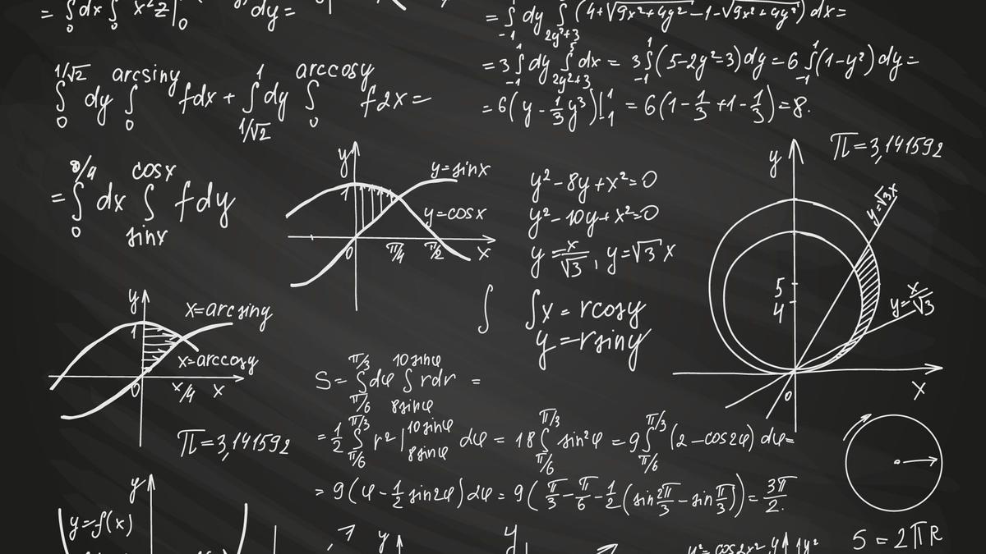
Real-World Applications of Discrete Mathematics
Presented by SHAYEKH AL HASAN 20243228

Slide 2
What is Discrete Mathematics?
Countable, Finite, and Distinct Mathematical Structures
Discrete mathematics focuses on mathematical objects that can be counted, such as integers, graphs, and logic.
Graph Theory
Studying networks, social media, and transportation maps using graph theory concepts.
Boolean Algebra
Applying logical operations (AND, OR, NOT) to power digital circuits, logic gates, and AI decision-making.
Combinatorics
Analyzing discrete structures to solve problems in data compression, error detection, and optimization.
Number Theory & Modular Arithmetic
Providing the mathematical foundation for cryptographic techniques like RSA encryption.
Applications of Discrete Mathematics:
Computer Networks & Internet Routing
Artificial Intelligence & Machine Learning
Cybersecurity & Data Integrity
Data Compression & Error Detection

Slide 3


CRYPTOGRAPHY: ENCRYPTION & DECRYPTION USING DISCRETE MATHEMATICS
An introduction to how cryptography uses principles of discrete mathematics, such as modular arithmetic and prime numbers, to encrypt and decrypt data for secure communication.

Slide 4




HOW ENCRYPTION WORKS (MATHEMATICAL PERSPECTIVE)
Key Generation
Encryption Process
Decryption Process
Choose two large prime numbers (p and q), compute n = p × q, Euler's totient function ϕ(n) = (p - 1)(q - 1), choose an encryption exponent e such that gcd(e, ϕ(n)) = 1, and compute the private key d where d × e ≡ 1 (mod ϕ(n)).
Convert the message (M) into a number, and use the formula: C = M^e mod n to get the ciphertext (C).
Use the formula: M = C^d mod n to retrieve the original message (M) from the ciphertext (C).

Slide 5

CRYPTOGRAPHY: ENCRYPTION & DECRYPTION USING DISCRETE MATHEMATICS
Cryptography is a critical field that relies on the principles of discrete mathematics to ensure secure communication in our digital world. It uses mathematical concepts like modular arithmetic, prime numbers, and discrete logarithms to encrypt and decrypt data, protecting sensitive information from cyber threats.

